Slide 1
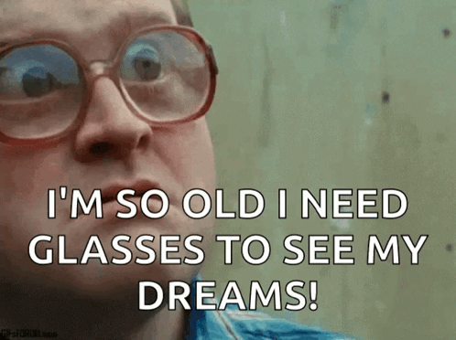
Analyzing Life Expectancy Factors
Hanieh Rajabpour
James Kenny

Slide 2
Project Overview
Our project aims to conduct a comprehensive analysis of life expectancy factors, exploring the relationships between happiness, alcohol consumption, GDP, and life expectancy across different countries. The primary goal is to derive actionable insights that can inform healthcare interventions and guide insurance risk assessment.
Notes:
Our project aims to Conduct a comprehensive analysis of life expectancy factors.Explore relationships between happiness, alcohol consumption, GDP, and life expectancy.

Slide 3
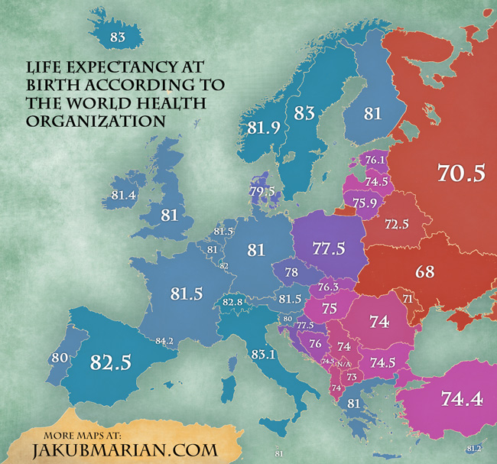
Hypothesis:
In countries around the world, higher life expectancy is positively correlated with higher happiness scores and GDP, and negatively correlated with alcohol consumption. Additionally, there may be a significant correlation between life expectancy and average BMI, indicating the influence of health and lifestyle factors on longevity.
Notes:
In countries around the world, higher life expectancy is positively correlated with higher happiness scores and GDP, and negatively correlated with alcohol consumption. Additionally, there may be a significant correlation between life expectancy and average BMI, indicating the influence of health and lifestyle factors on longevity.

Slide 4
Business Problem:
In the proposed project, we aim to analyze how life expectancy is influenced by factors such as happiness, alcohol consumption, GDP . This analysis has significant implications for the healthcare and insurance industries. It can guide healthcare providers in developing targeted health interventions and assist insurance companies in refining risk assessment and product development. By understanding the impact of these variables on life expectancy, these industries can enhance their service offerings, optimize resource allocation, and ultimately improve health outcomes.
Notes:
This analysis has a significant impact on healthcare and insurance companies. It can Helps healthcare companies develop specific health plans.
And also insurance companies in refining risk assessment and product development.
They can enhance their service offerings, optimize resource allocation, and improve health outcomes.

Slide 5
Data Acquisition, Enrichment, and Examination
Primary Dataset:
Collected data on life expectancy, happiness, alcohol consumption, and GDP from Kaggle.
Primarily sourced from global databases and surveys.
Supplemental Dataset:
Complementary data obtained from additional sources to enrich the analysis.
Utilized World Bank and WHO datasets for cross-verification and completeness.
Challenges Faced:
Year Mismatch:
Primary dataset and supplemental datasets had discrepancies in reporting years.
Integration was challenging due to inconsistencies in the temporal alignment of data.
Notes:
Our challenge was to find datasets exactly aligned with our main dataset in both context and timetable.

Slide 6
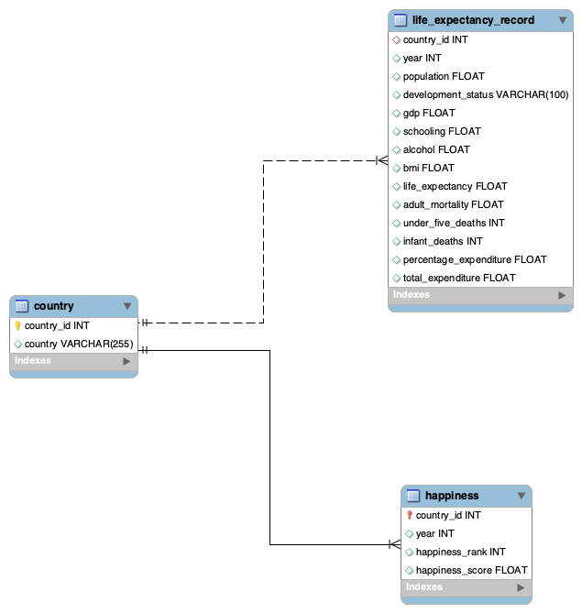
Database Design & Data Transformation
Process
My SQL code to create tables and define foreign keys.
Created individual csv’s in Jupyter notebook to populate data.
Data import wizard.
Reverse engineered to create ERD.
Challenges
Data sets had different naming conventions for countries.
Year mismatch.
Solutions
Python functions to reformat country names.
Found one year overlap and adjusted plan for analysis.
Notes:
Provide a concise visualization or description of the Entity-Relational-Model.
Discuss the key challenges faced during data transformation, such as inconsistencies, and how they were addressed.

Slide 7
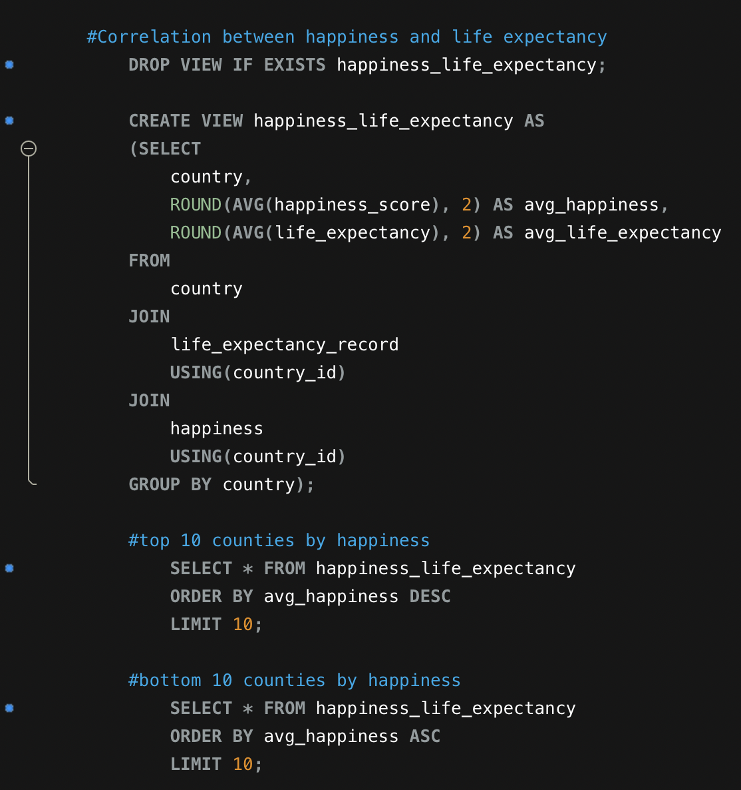
SQL Insights & Advanced Analysis
Process
My SQL queries to calculate insights.
Created views for exports to tableau.
Insights
Highest life expectancy Slovenia - 88.
Zimbabwe increased life expectancy by 21 years from 2000 to 2015.
Developed countries life expectancy is 12 years higher than developing countries.
Happiness has a strong correlation with life expectancy - 0.75 pearson correlation coefficient.
Notes:
Showcase one or two standout insights derived from advanced SQL queries.
Highlight any specific analyzes that were particularly challenging or revealing.

Slide 8
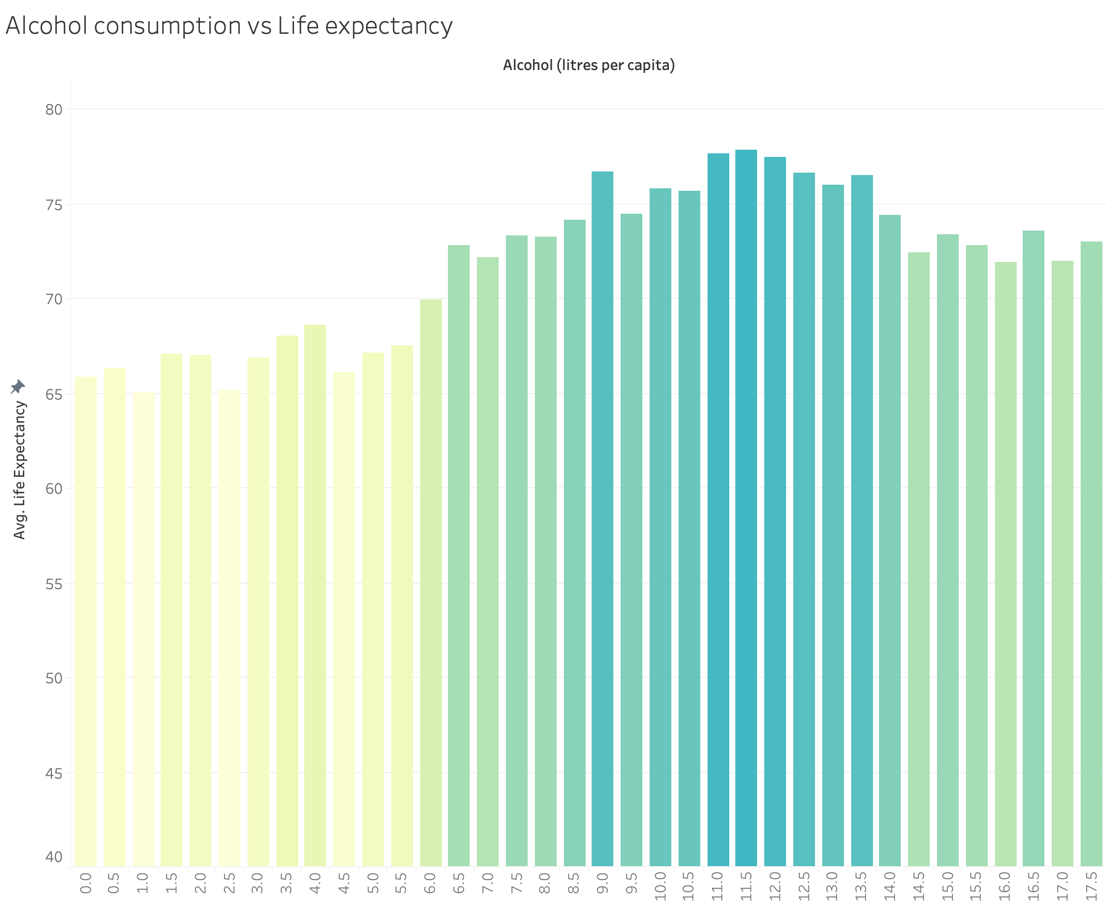
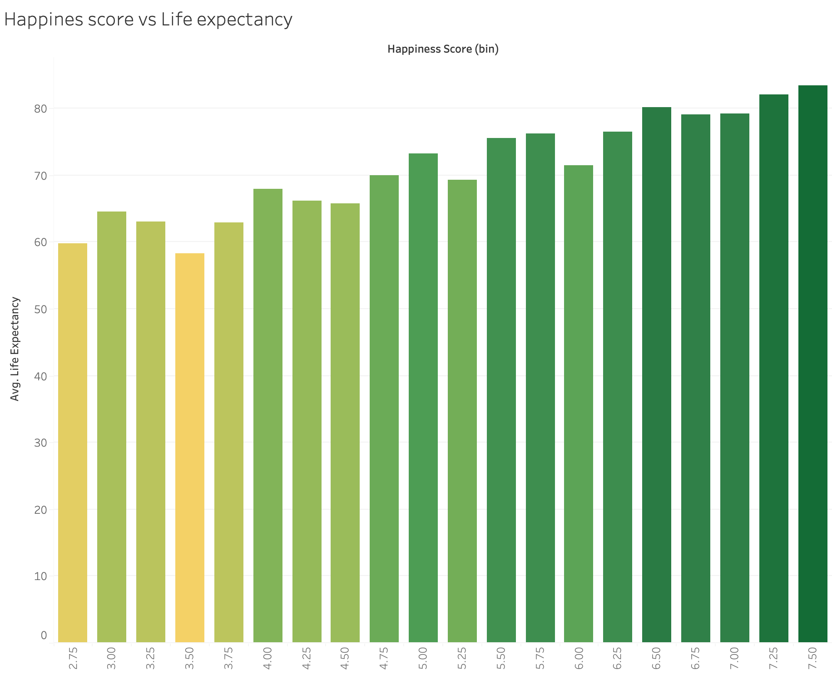
Visualization & Key Insights
Health Factors
Correlation: 0.4
Correlation: 0.75
Notes:
Show some of the primary visualizations developed.
Discuss the major insights derived from the visualizations.

Slide 9
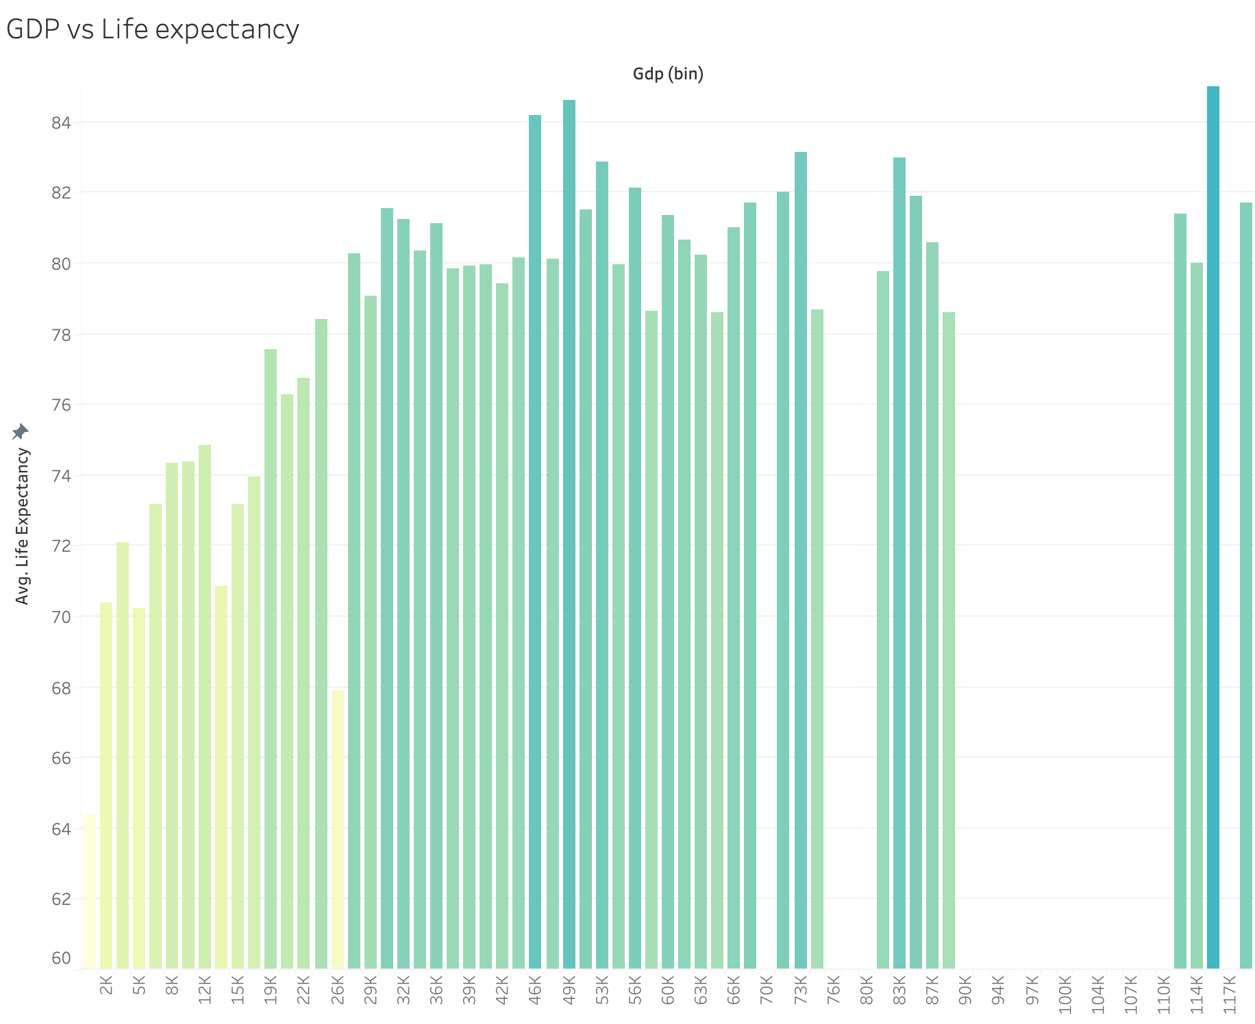
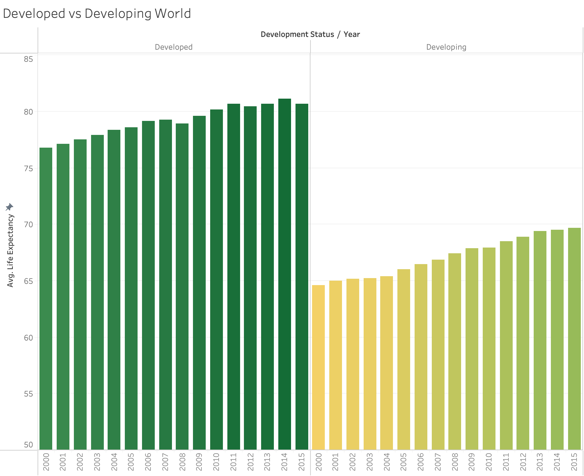
Visualization & Key Insights
Societal Factors
Correlation: 0.43
Notes:
Show some of the primary visualizations developed.
Discuss the major insights derived from the visualizations.

Slide 10
Conclusions
Conclusions:
Alcohol Consumption and Life Expectancy:
Our hypothesis that alcohol consumption correlates with lower life expectancy proved to not be entirely accurate.
While extreme high alcohol consumption rates do appear to negatively correlate with life expectancy, moderate alcohol consumption appears to actually correlate with higher life expectancy,
GDP and Life Expectancy:
Moderate positive correlation observed between GDP and life expectancy.
Countries with higher GDP tend to have slightly increased life expectancies.
The project's findings provide actionable insights for both the healthcare and insurance sectors. Ongoing collaboration, continuous monitoring, and adaptation are essential to stay responsive to changing health dynamics and customer needs. This evidence-based approach positions the industries to enhance service offerings, improve health outcomes, and make informed strategic decisions.
Notes:
Alcohol consumption is not significantly correlated with lifetime expectancy bud extreme consumption is
Moderate positive correlation observed between GDP and life expectancy.Countries with higher GDP tend to have slightly increased life expectancies
And significant positive correlation with happiness

Slide 11
Business Implications:
Healthcare Industry:
Targeted Health Interventions: Develop interventions to enhance happiness and mental well-being.
Preventive Health Programs: Design programs addressing alcohol-related health risks.
Mental Health Initiatives: Promote mental health awareness and support.
Insurance Industry:
Refining Risk Assessment: Incorporate happiness and alcohol consumption metrics into risk assessment models.
Tailored Products: Develop insurance products tailored to customers' happiness and lifestyle profiles.
Wellness Programs: Introduce wellness programs aligned with mental health and alcohol awareness.
Resource Allocation Optimization:
Data-Driven Decision-Making: Utilize insights for resource allocation based on identified influencing factors.
Efficient Service Offerings: Optimize healthcare services based on specific determinants influencing life expectancy.
Strategic Decision-Making:
Pricing Strategies: Adjust insurance premium pricing strategies based on risk profiles derived from the analysis.
Competitive Advantage: Leverage insights to gain a competitive edge in the insurance market.
Improved Health Outcomes:
Customer Education: Implement educational initiatives to raise awareness of lifestyle factors affecting health and insurance.
Notes:
Targeted Interventions:
Develop interventions for enhanced happiness and mental well-being.
Preventive Programs:
Design programs addressing alcohol-related health risks.
Mental Health Support:
Promote awareness and support for mental health.
Insurance Industry:
Risk Assessment Refinement:
Incorporate metrics like happiness and alcohol consumption into risk models.
Tailored Products:
Develop insurance offerings personalized to customers' happiness and lifestyle.
Wellness Programs:
Introduce programs aligning with mental health and alcohol awareness.
Use insights for efficient resource allocation.
Tailor healthcare services based on influencing factors.
Strategic Decision-Making:
Adjust insurance premiums based on risk profiles from analysis.
Improved Health Outcomes:
raise awareness of lifestyle factors affecting health and insurance.

Slide 12
Major Obstacle
Missing Data:
Some countries had incomplete data for happiness, alcohol consumption, or GDP, impacting the analysis.
Inconsistencies in reporting or lack of data for specific years posed challenges.
Data Discrepancies:
Discrepancies in how happiness, alcohol consumption, and GDP were measured across countries.
Harmonizing these diverse metrics for meaningful comparisons proved challenging.
Learnings:
Importance of Data Cleaning:
Recognized the criticality of thorough data cleaning and validation before analysis.
Developed a deeper appreciation for the impact of missing or inconsistent data on outcomes.
Contextual Understanding:
Gained insights into the importance of understanding the context and nuances of data sources.
Acknowledged the need for contextual interpretation and handling of diverse metrics.
Notes:
Missing Data:
Data Discrepancies in how happiness, alcohol consumption, and GDP were measured across countries.
Data Cleaning and validation are critical for reliable analysis and missing data can affect the quality of outcomes
Context Matters:
Understanding the context of data sources is very important when dealing with diverse metrics.

Slide 13

Thank You!
Analyzing Life Expectancy Factors
Team Members:
James Kenny
Hanieh Rajabpour

